Slide 1

Augmented Reality museum “Yasser Arafat Museum”
Prepared by
Muna Anwar Abu Gharbieh 1160407
Birout Bani Odeh 1160587
Bayan Mohareb 1160621
Supervised by
Dr. Iyad Tumar.

Slide 2
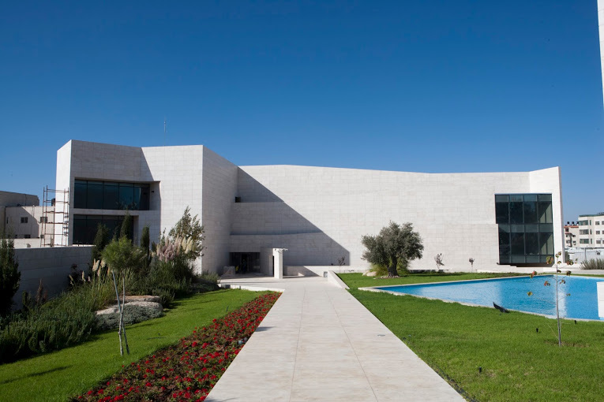
Motivation
Through the study we devoted the application of Augmented reality on museums because it most important places that are a link between the past and the present, and also work to teach people and the heritage transmission over time, also museum represent history , also we chose “Yasser Arafat” Museum.
Through the application of augmented reality, users no longer need a tour guide.

Slide 3
Outline
Chapter 1 (Introduction)
Chapter 2 (Related work & Background)
Chapter 3 (Proposed Work)
Chapter 4 (Result and Analysis)
Chapter 5 (conclusion and future work)

Slide 4
1. Introduction
Many museums have had difficulty interpreting their exhibits to a large number of visitors using the traditional system was a phrase to display and preserve artifacts and provide details only .
also lacks the active participation of visitors, whether children or students and learn with themselves .
so they resorted to using digital technologies to create an interaction between visitor and exhibitions to learn from things.

Slide 5
there are many of these technologies such as the use of multimedia and phone applications these way provide personal participation in the learning process also search to use 3D technologies.
On the other hand, Augmented Reality can provide interaction as intuitive as handling normal physical objects. It can be used on commercial handheld devices and it can be adjusted according to ergonomic requirements and it works to simulate the real reality by add 3D forms and multimedia to improve reality.

Slide 6
1.1 Problem Statement
This project tries to answer the following questions:
Would the museum visitors be more attuned to Passive Interaction or Active Interaction in Augmented Reality?
How can an Augmented Reality application for the “Yasser Arafat” exhibit be designed and developed using commercial?
What are the effects of augmented reality on learning in the context of a museum when displaying information, it?

Slide 7
1.2 Contribution
we have created a miniature application that enables the visitor upon entering the museum to download this application on his own phone, and direct towards the objects that we have chosen so that this object is displayed in the augmented reality environment, with different effects, whether it is an audio, video or digital display of information Related to the thing.

Slide 8
2. Related Works
Augmented reality is known to generate a composite user view that mixes the real scene the user is looking at and the computer-generated virtual scene that enhances the real scene with additional information.
Therefore, we conducted previous studies for many museums that implemented augmented reality, including them:

Slide 9
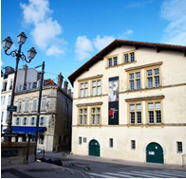
As an experimental study was carried out on the Bayonne Museum of Art and History, they asked specific questions to see if augmented reality would be helpful or not?
The study also aims to answer the following question: Do these three different methods (stickers M, audio guide and M.A.R.T.S system) enable visitors to acquire the same level of knowledge?

Slide 10
According to the studies of the Malaysian National Museum management .
Through a study conducted on the museum itself with specialists and researchers in the field of AR , it displays the questions that were directed to them.
Interview Questions
Does the Museum provide any digital tour before?
Do you know anything about Augmented Reality (AR)? Have you ever experienced AR or using the technology?
What do you think about adopting Augmented Reality in the Museum?
Is it feasible to adopt Augmented Reality in the Museum? Why?

Slide 11
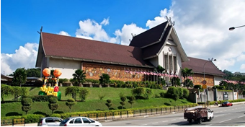
In conclusion for both museum, study's received positive results on the practical application of AR technology, which confirms the feasibility of adopting this technology in the approach of the current museum exhibition.

Slide 12
2.1 Advantage of AR:
Any one can download application on own mobile without any specific tools such as :glasses..etc.
provide more levels of interactivity and entertainment
Tourist can share and express her/his opinion with others within the application or outside.
Creative tool for education.
The ability to interact with an application using different languages.

Slide 13
2.2 Disadvantage of AR :
These applications need high costs to develop them.
Applications are somewhat heavy on the devices.

Slide 14
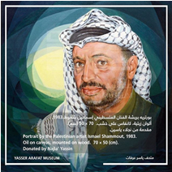
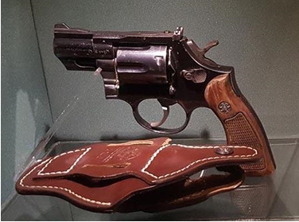
3. Proposed Work
we will choose some of object from Yasser Arafat Museum to make full system contain application mobile for museum with augmented reality for selected objects.
The user sees a video showing part of
Yasser Arafat's life and his heroics.
the application allows user to see the Gun in 3D by modeling it, in addition to add historical music.

Slide 15
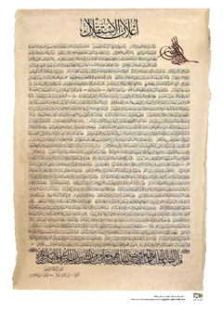
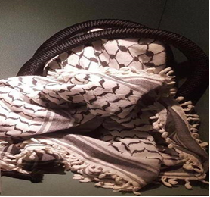
Declaration of Independence document: upon seeing this object, the user sees the document translated in English, in addition to an audio of part of the document in English.
Yasser Arafat's Koffiyeh: Upon seeing this object, the user sees a video showing part of the history of the Palestinian people

Slide 16
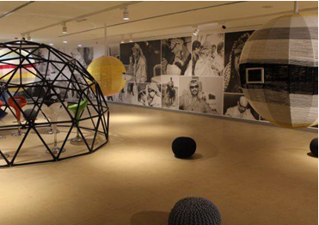
Exhibition hall: the user sees an image that shows what the exhibition hall is and information about it.

Slide 17
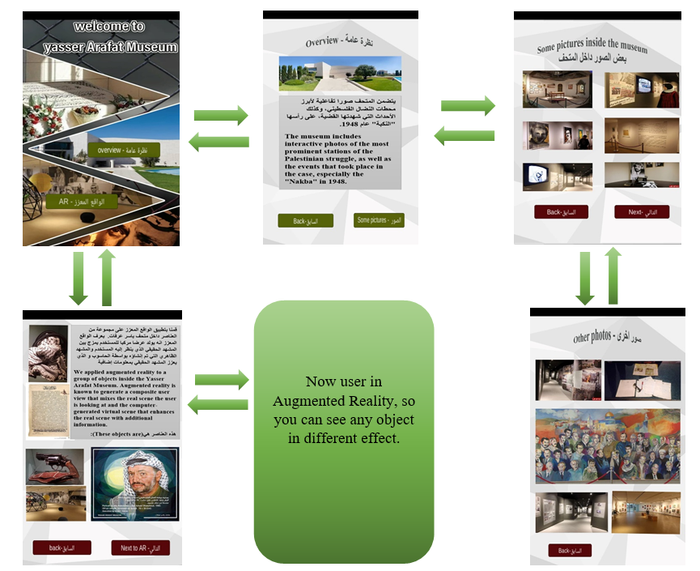
4. Result and Analysis

Slide 18




Tools and Technology's:

Slide 19
Challenges
Corona virus was considered our biggest challenge, and we could not visit the museum.
Remote communication during the project implementation period.

Slide 20
5.1 Conclusion
we see that the AR enables assistance in upgrading in the way to display the objects inside the museum by increasing the interaction between visitors and thus strengthening Visitor experience.

Slide 21
5.2 Future work
We hope to develop this application to include other components inside the museum that have not been worked on.
In addition, many advanced techniques can be added, such as adding a counter that counts the remaining elements that are not displayed during use, or the samples that have been selected can be displayed in the form of a story sequentially using more than one scene.

